Slide 1


ZiuZ Visual Intelligence
Presentatie
‘To make a difference by solving issues relevant to society’
Determined to make a difference!
Cor
Notes:
Confidentiality level: Confidential

Slide 2
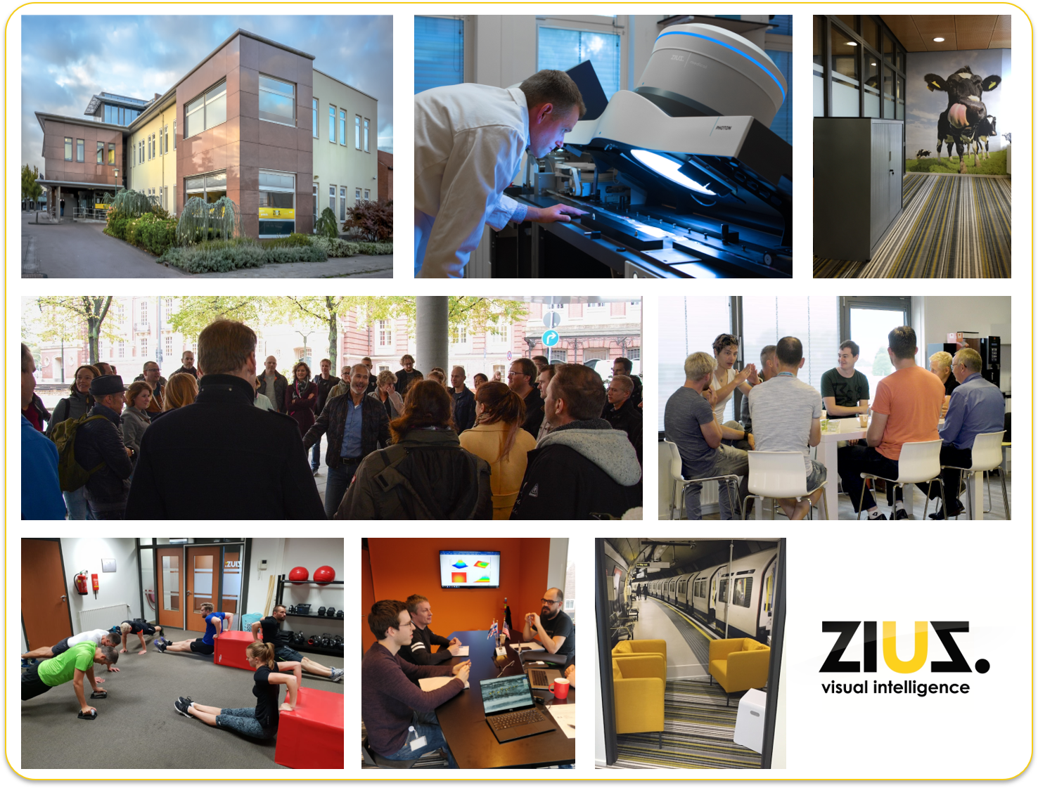

ZiuZ in a Nutshell
Established in 2002
Privately owned
HQ in Gorredijk, Netherlands
68 people of which 32 in R&D
Solving social relevant issues with Visual Intelligence technology
Innovative & customer centric
Have impact!
https://www.ziuz.com

Slide 3

Active Worldwide …

Slide 4

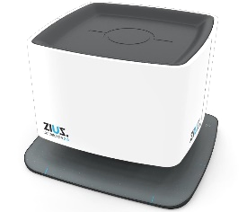

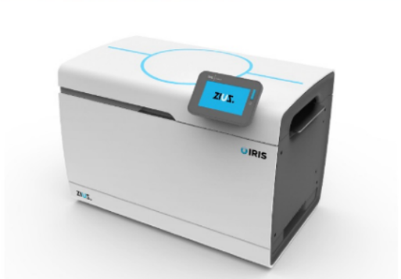
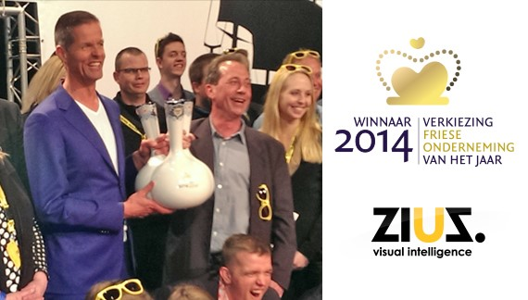
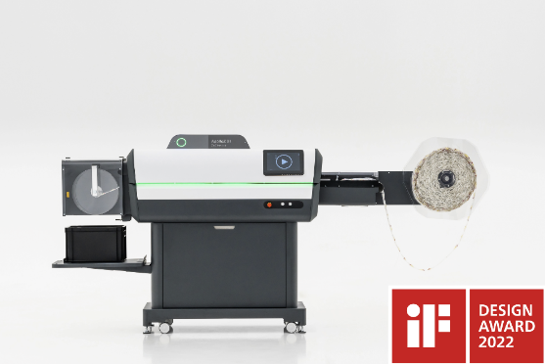
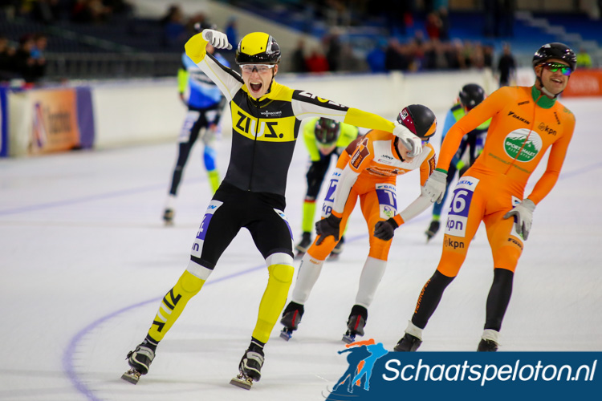
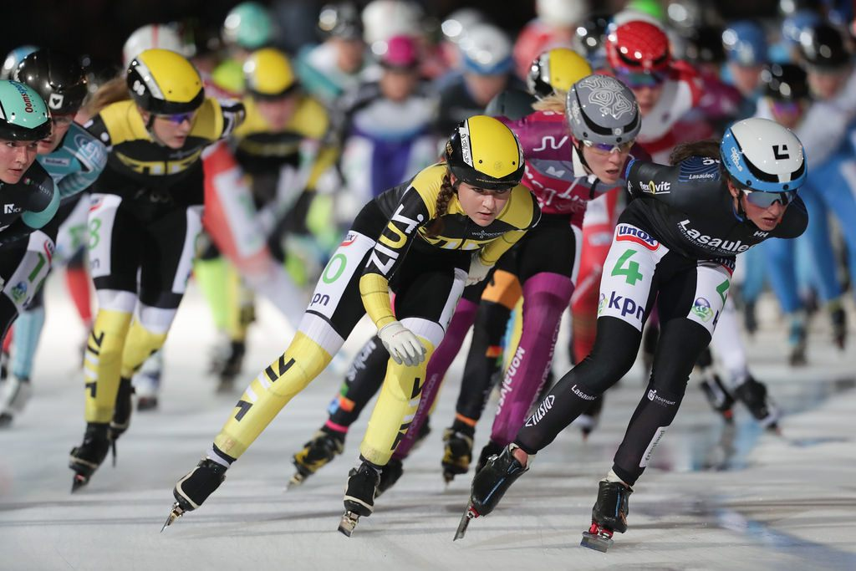
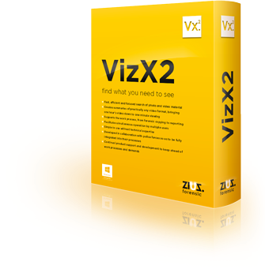
… Determined to Win!
WINNER
ELECTION
FRYSIAN
COMPANY
OF THE YEAR

Slide 5


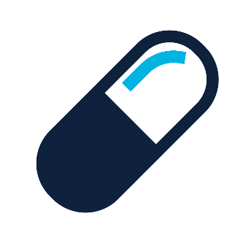



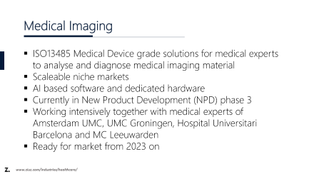
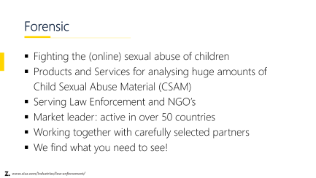
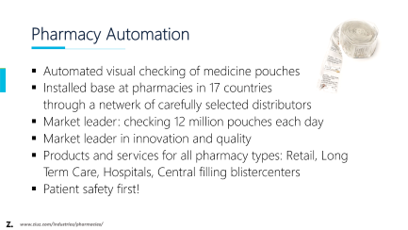
We Focus on These Industries
www.ziuz.com/industries

Slide 6
Forensic
Fighting the (online) sexual abuse of children
Products and Services for analysing huge amounts of Child Sexual Abuse Material (CSAM)
Serving Law Enforcement and NGO’s
Market leader: active in over 50 countries
Working together with carefully selected partners
We find what you need to see!
www.ziuz.com/industries/law-enforcement/

Slide 7
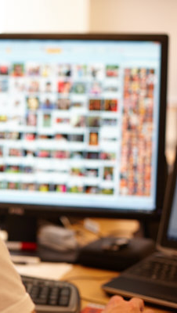
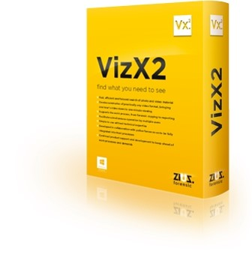

ZiuZ Forensic main portfolio
VizX
Used by Law Enforcement Agencies worldwide in their fight against the sexual abuse of children.
Fast and Effective Workflow
Everything integrated in one system
Simplicity
Including video
ICCAM
Developed in close cooperation with INHOPE, the global network of hotlines, to root out child sexual abuse from the internet.
Automated processing of reports from the public
Automated crawling of websites
Enhanced capability to match, identify and analyze CSAM
Extensive reporting system
www.ziuz.com/industries/law-enforcement/

Slide 8
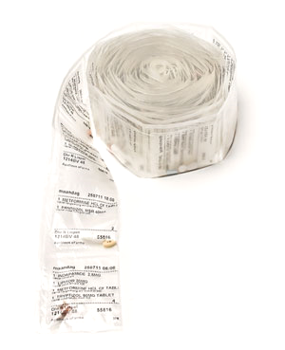

Pharmacy Automation
Automated visual checking of medicine pouches
Installed base at pharmacies in 17 countries
through a netwerk of carefully selected distributors
Market leader: checking 12 million pouches each day
Market leader in innovation and quality
Products and services for all pharmacy types: Retail, Long Term Care, Hospitals, Central filling blistercenters
Patient safety first!
www.ziuz.com/industries/pharmacies/

Slide 9
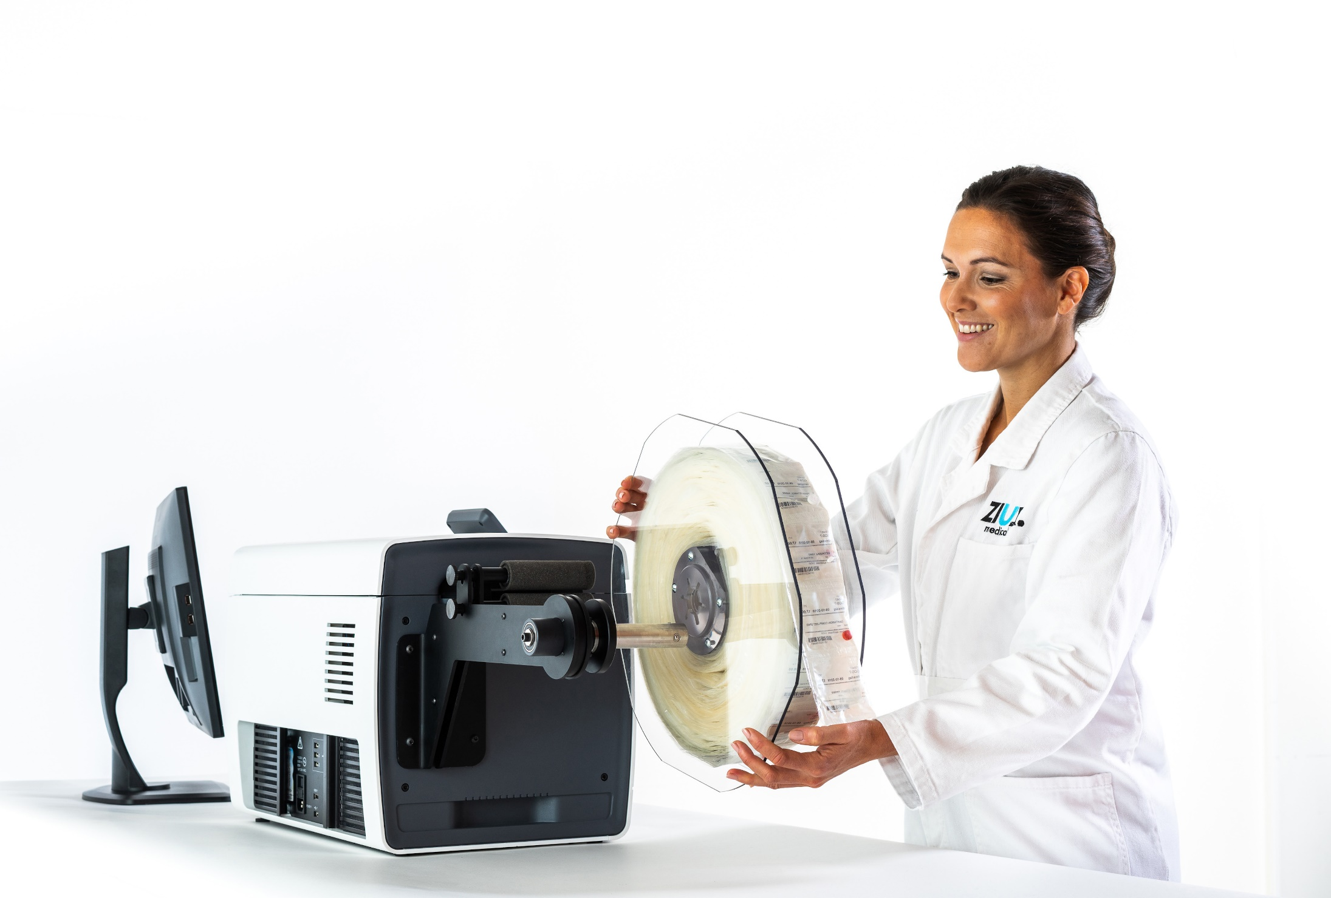
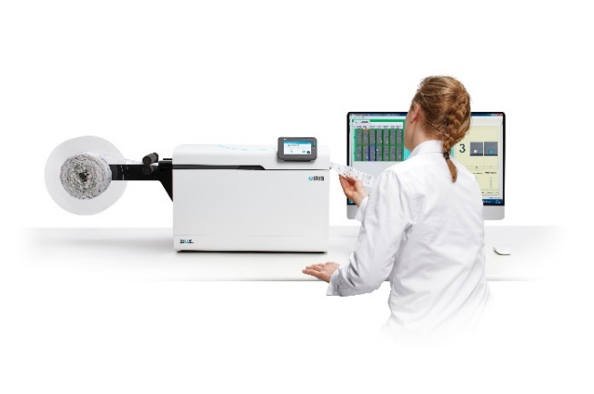
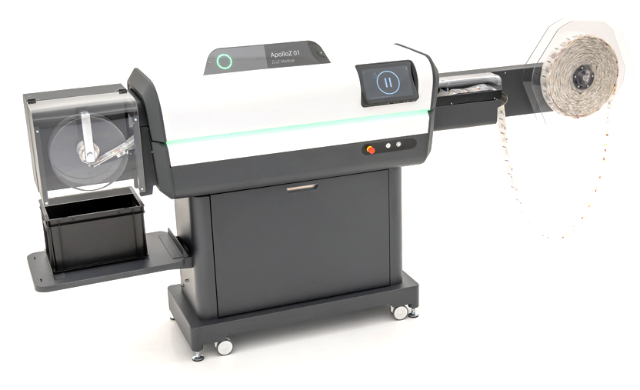
Pharmacy Automation main portfolio
IRIS
Low volume, cost effective medicine pouch checking device for Retail and Hospital pharmacies.
Automatically checking up to 5.000 pouches an hour
Plug & play installation and intuitive user interface
Best in the market performance with difficult medicines *
Feed in with reel or by hand
* Patent protected lightning and camera system
ApolloZ
High volume, best quality medicine pouch checking device for Long Term Care and Central filling pouch centers.
Automatically checking up to 12.000 pouches an hour
Works with every pouch packaging machine and foil on the market
Best in the market performance with difficult medicines *
Performance reporting tools for optimizing pouch production
Optional inline PRM for Cutting & Winding patient roles
www.ziuz.com/industries/pharmacies/

Slide 10
Medical Imaging
ISO13485 Medical Device grade solutions for medical experts to analyse and diagnose medical imaging material
Scaleable niche markets
AI based software and dedicated hardware
Currently in New Product Development (NPD) phase 3
Working intensively together with medical experts of Amsterdam UMC, UMC Groningen, Hospital Universitari Barcelona and MC Leeuwarden
Ready for market from 2023 on
www.ziuz.com/industries/healthcare/

Slide 11
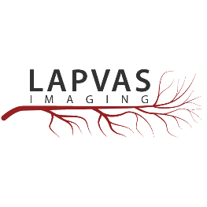
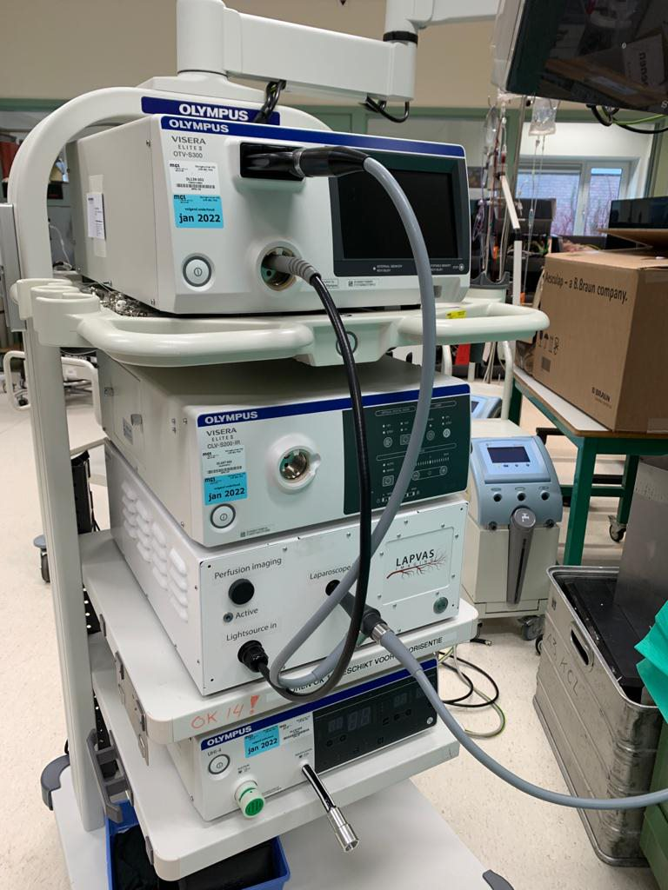
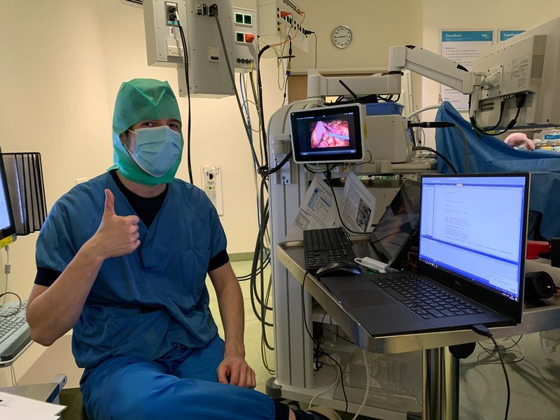
Medical Imaging first product launch
PerfusiX
A medical device that presents the surgeons a real-time heatmap of the blood flow using Laser Speckle Contrast Imaging
The heat map can help select the optimal site for the anastomosis
In collaboration with LIMIS Development B.V.
and Medical Center Leeuwarden
www.ziuz.com/industries/healthcare/

